Slide 1
Autonomous Vehicles
By Eric Mai

Slide 2
What are they?
A self-driving car or autonomous vehicle is a vehicle that can drive and make decisions on its own with little or without any human input.

Slide 3
Technology Used
Cameras are placed around these vehicles which allows the computer system to perceive lane lines, road signs, hand signals, pedestrians, other vehicles, and a lot of other useful information.
Radar allows the computer system in the car to be able to detect moving objects.
Lidar builds a map of the world around the car by shooting out millions of light pulses every second and measuring how long they take to come back.

Slide 4
First Autonomous Vehicle?
One of the first self-sufficient and truly autonomous cars was known as the ALV, which used color-based segmentation of the pixels that the camera detects to differentiate the road from non-road.
There are issues with this color-based segmentation approach for road navigation due to shadows, insufficient color differences between road and non-road, and subtle changes to road boundaries.

Slide 5
Using Artificial Neural Networks
Development of ALVINN which is a 3-layer back-propagation artificial neural network used to control the NAVLAB, the Carnegie Mellon autonomous navigation test vehicle.
Used supervised learning, by taking in input images as well as corresponding steering angles from a human driver to learn how to steer.
Had problems where if it came across a situation that it was not trained to deal with, the network had to be retrained.

Slide 6
Deep Learning
Excels at classifying objects and pedestrians.
After having learned to recognize a particular pattern, it can extend that capability to objects that it hasn’t seen before. Thus, there is no need to retrain the network on every single new thing it sees.
Largely used today for autonomous vehicles.

Slide 7
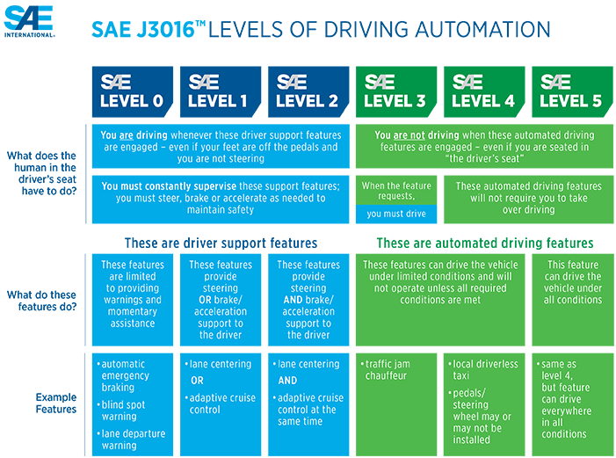
Levels of Driving Automation

Slide 8
Positive Impacts
Will reduce traffic congestion since self-driving cars may be connected to the same network so that they can plan accordingly on which paths will avoid congestion.
Less resource consumption since self-driving cars can travel in a platoon formation.
Automobile accidents are largely attributed to human driver error. Will eliminate the need for human control, which will lead to generally safer roads.
Allows people with disabilities or younger and older age groups to be able to travel around.

Slide 9
Negative Impacts
Hackers with malicious intent will be a major threat since they could cause a considerable number of accidents by hacking into the computer systems of an autonomous vehicle.
Will replace the need of human drivers, thus there will be a considerable loss of jobs for people who work in transportation business such as taxi drivers.

Slide 10
Ethics
Often compared to the Trolley Car dilemma.
Given the situation where a self-driving car finds itself being forced to crash into a group of pedestrians and killing them or turning to save the pedestrians but crashing into a wall killing the driver, which is the correct decision to make? Should the autonomous vehicle prioritize saving its owner at all costs or should it prioritize reducing casualties for the greater good?
Another example is that suppose there is a situation where the self-driving car must make a left or right turn in a highway, otherwise it will crash into a truck in front of it. On the left of the self-driving car is a person on a motorcycle with a helmet on, and to the right is a person on a motorcycle without a helmet on. Should the self-driving car turn left and crash into the person with the helmet on as they are more likely to survive or should the self-driving car turn right and crash into the person without a helmet on? If the car crashes into the person with the helmet on, then it is not fair for the car to punish the more responsible motorcyclist, and if the car crashes into the person without the helmet on, then the car has just betrayed its goal of reducing casualties.
Who should the accountability fall under when an unavoidable accident is almost guaranteed to occur?

Slide 11
Thank you

